Slide 1
Regulation and Enforcement at the Consumer Financial Protection Bureau 2018 Update
Through the Looking Glass
Ryan Scarborough & Rachel Rodman
Williams & Connolly LLP
January 12, 2018

Slide 2
Overview
The Changing of the Guard
Status of new (Acting) Director
Current impacts
CFPB Refresher
How does the Bureau’s structure impact the timing and extent of change?
Possible policy shifts at the Bureau and beyond
2017 in Review
Supervision
Enforcement
Regulation

Slide 3
Today’s Presenters
Ryan Scarborough, a partner at Williams & Connolly LLP, regularly defends matters involving the Consumer Financial Protection Bureau, the Federal Deposit Insurance Corporation, the Office of the Comptroller of the Currency, the Federal Housing Finance Agency, and other financial regulatory agencies. He has been recognized by The Legal 500 for his “calming approach” when advising financial institutions and high-ranking executives across a range of litigation and enforcement actions. His most recent article, Sometimes It Pays to Litigate Against the CFPB, appeared in the October 13, 2017 issue of Law360.
Rachel Rodman, Counsel at Williams & Connolly LLP, represents banks, specialty finance and Fintech companies, and other providers of consumer financial products and services. From 2011-2013, Rachel served as Senior Counsel in the CFPB’s Legal Division, and from 2013-2016 she served as an Enforcement Attorney in the Division of Supervision, Fair Lending and Enforcement, where she led investigations of banks and nonbanks involving overdraft practices, debt collection, mortgage servicing, and consumer reporting. Prior to joining the CFPB, Rachel was an associate at Williams & Connolly LLP from 2004 until 2011.

Slide 4
Part I: Changing of the Guard

Slide 5
CFPB Leadership Fight Five Days in November
11/24/17: Director Cordray appoints his chief of staff, Leandra English, as Deputy Director
Cordray resigns and indicates that English will serve as Acting Director (by operation of Dodd-Frank Act) until Senate confirms nominee
Several hours later, President Trump appoints OMB Director Mick Mulvaney as Acting Director pursuant to the Vacancies Reform Act
11/25/17 DOJ Office of Legal Counsel issues memo concluding that Vacancies Reform Act is not superseded by Dodd-Frank
CFPB General counsel issues memo advising Bureau personnel that Mulvaney is the Acting Director
11/26/17 English files TRO in federal district court for the District of Columbia to enjoin Mulvaney from Acting Director position
11/27/17 DONUTS!!!
11/28/17 District Court denies TRO

Slide 6
What Law Controls?
Dodd-Frank Act
12 U.S.C. § 5491
Vacancies Reform Act
5 U.S.C. § 3345 et seq.
Deputy Director “shall serve as acting Director in the absence or unavailability of the Director”
Key Questions
Does vacancy = absence or unavailability?
Does Dodd-Frank expressly displace the Vacancies Reform Act?
Does the independent nature of the Bureau affect the analysis?
Does the interpretation advanced by English intrude upon core Executive Branch functions?
Does English have standing?
Provides exclusive means of filling vacancies on an acting basis unless another statute “expressly” provides a mechanism for acting service
Key Questions
Does the Vacancies Reform Act cease to apply in a non-exclusive context, or does it provide an alternative method?
Is there any conflict with Dodd-Frank?
What constitutional issues arise if president is denied ability to exercise authority?

Slide 7
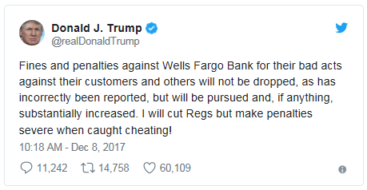
Immediate Impacts
Temporary freeze on regulations, new hiring
Review of enforcement activity
Pending investigations
Authority to Sue / Post-NORA
Active litigation
Visible changes
Suspended investigation of company (Nexus Services) that guarantees bond for immigrant detainees in exchange for them paying a fee for GPS locator services while a court considers legal challenge to the CID
Altered litigation position it took in Nationwide Biweekly matter concerning whether the defendant needed to post a bond on appeal
Third biennial report on credit card market visibly changes tone from past reports, adopting objective/descriptive language and dropping references to “areas of concern” in the market

Slide 8
Current State-of-Play
On January 10, District Court (Kelly, T.) denies English’s motion for prelim. injunction, setting up a route for English to appeal to the D.C. Circuit.
The court holds that:
English was unlikely to succeed on the merits of her claim because (1) the President had authority under the FVRA to appoint Mulvaney, and (2) the succession provision of the Dodd-Frank Act does not displace that authority
English’s loss of the “right” to serve as Acting Director did not constitute irreparable harm
The equities and public interest favored leaving Mulvaney in place, as he was already functioning as the agency’s Acting Director

Slide 9
Part II: CFPB Refresher

Slide 10
Statutory Mandate
Bureau established in July 2010 by Title X of the Dodd-Frank Wall Street Reform and Consumer Protection Act, 12 U.S.C. § 5301
Title X:
Created the Bureau and is the source of its authorities
Consolidated enforcement of 18 separately enumerated consumer protection statutes
Established new “UDAAP” prohibition against “unfair, deceptive, and abusive acts and practices” (Sections 1031 and 1036 of Title X)
Established the Bureau’s consumer protection mandate
12 U.S.C. § 5511.

Slide 11
Independent Agency Led by a Single Director
Bureau is led by a single Director appointed by the President, with advice and consent of Senate, for a 5-year term, and (per the statute) still only removable only for cause.
Director retains control over funding:
Requests for funding are made “in the amount determined by the Director”;
Director has authority to “determine the character of and the necessity for the obligations and expenditures of the Bureau”
Powers of the Bureau, exercised through the Director, are substantial and include:
Directing the establishment and maintenance of divisions and offices
Coordinating the operation of all administrative, enforcement, and research activities
Implementing Federal consumer financial laws through rules, orders, guidance, examinations, and enforcement actions

Slide 12
Who Does the Bureau Regulate?
The Bureau regulates bank and non-bank providers of consumer financial products and services and their service providers. Jurisdiction is determined by what you do, not who you are (bank vs. non-bank).
There are three jurisdictional pieces under Title X:
Are you a “covered person” because you “engage in” offering or providing a “consumer financial product or service”?
If you are a “covered person” or “service provider,” are you otherwise exempt under Title X?
Are you a “service provider” because you provide a “material service” to a “covered person” in connection with that person’s offering or provision of a consumer financial product or service?

Slide 13
Bureau’s Powers
The Bureau’s functions are defined by statute. . .
. . . and achieved through 5 primary tools
Rulemaking
Supervision
Enforcement
Consumer Education
Consumer Complaints
Source: Section 1021(c)

Slide 14
Internal Organization
The Bureau is organized first by division and then by offices within those divisions. Core work performed by:
Division of Supervision, Enforcement & Fair Lending
responsible for all examination and enforcement work
Division of Research, Markets & Regulation
responsible for market monitoring, market studies, and rulemaking
Office of Director
Division of Consumer Education & Engagement
responsible for external outreach and messaging to consumers
Office of Consumer Response (within Operations Division)
responsible for collecting, investigating, and responding to consumer complaints

Slide 15
Part III: 2017 Update

Slide 16
Supervision

Slide 17
How Does the Bureau Choose Who to Examine?
Unlike prudential regulators, the Bureau does not operate on a static exam schedule
Supervision prioritizes exam work through a “risk based” approach that focuses on:
Size of a product market
Regulated entity’s share in that product market
Potential for consumer harm related to a particular product market
Market intelligence, including consumer complaints, whistleblower tips, and information sharing with other regulators and law enforcement agencies
Supervision must also coordinate priorities and resources with active Enforcement office

Slide 18
Strengthened AND Curtailed?
There may be an uptick in Supervisory activity under a new Director
Banking regulators (OCC, Fed, state banking commissions) have traditionally regulated financial institutions through Supervisory examinations
Enforcement actions are rare
Supervisory process is confidential
At the same time…expansion of non-Bank Supervision to new entities could be curtailed
Examinations of service providers
Supervision of other “larger participants” in the market for consumer financial products and services (e.g., installment and vehicle title lenders)

Slide 19
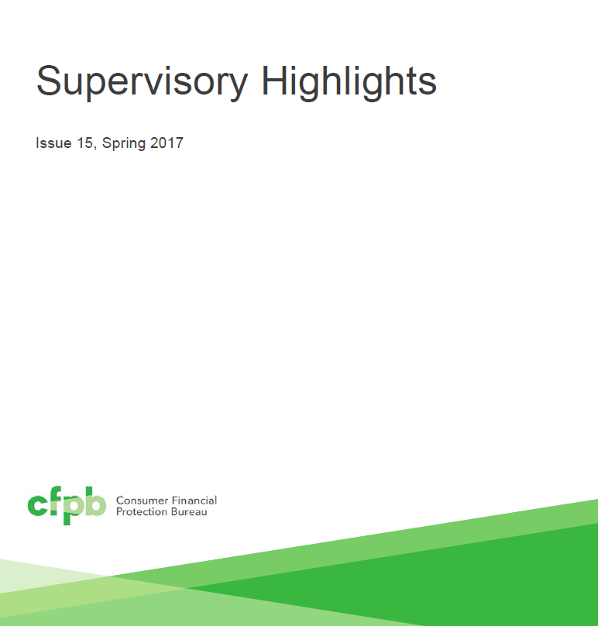
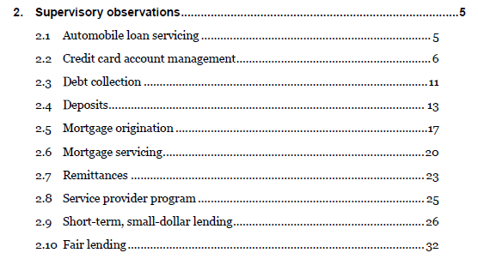
2017 Supervisory Activity

Slide 20
2017 Notable Supervisory Activity
Consumer Reporting Special Edition (March 2017)
Bureau releases a “special edition” for high priority areas to focus attention on and communicate its expectations regarding a particular market.
Sets out “vision” of a consumer credit system, relying on Reg. V framework
Focus on furnishers and vendor oversight
Spring Edition (April 2017)
Supervisory resolutions resulting in $6.1 million in restitution to more than 16,000 consumers during the review period.
Focus on mortgage origination (Ability to Repay rule), mortgage servicing (loss mitigation), student loan servicing (unfair practice in connection with deferments), and fair lending (proxy methodology)
Summer Edition (September 2017)
Supervisory resolutions resulting in $14 million in restitution to 104,000 consumers
Discusses Enforcement referral process known as “ARC.” In FY 2016, 10 percent of all examinations were ultimately referred to Enforcement, or one-third of exams considered in ARC process
Focus on auto loan servicing (repossessions as unfair practice), credit cards (Reg. Z, UDAAP), debt collection (FDCPA, UDAAP), deposits (Reg. E, UDAAP)

Slide 21
Enforcement

Slide 22
Aggressive Enforcement Agenda Under Director Cordray
The Bureau launched investigations and brought enforcement actions across many areas, such as credit card add-on products, student loans and loan servicing, mortgages and mortgage servicing, debt collection, and consumer credit reporting
It tallied more than $600 million in penalties. In 2015, Citibank acquiesced to a $35 million penalty; a year later, the CFPB achieved its high-water mark when Wells Fargo agreed to a $100 million penalty
CFPB Director Cordray touted “about $12 billion in relief to 30 million people who were cheated or mistreated” shortly before he resigned

Slide 23
Active Enforcement Caseload
Source: http://www.consumerfinance.gov/policy-compliance/enforcement/actions/

Slide 24
On the Chopping Block “Regulation by Enforcement”
CashCall (C.D. Cal.)
CashCall and affiliates sell high-cost, low-dollar consumer loans
Bureau argued that CashCall made loans in violation of state usury caps and licensing laws. Bureau claimed that by collecting on “void” loans, CashCall engaged in an unfair and deceptive practice
CashCall argued the case is an impermissible attempt to enforce state law
Court awarded summary judgment to Bureau in August 2016 decision
Trial on damages and civil money penalty held in October 2017
Ocwen (S.D. Fla.)
Ocwen is the country’s largest non-bank mortgage servicer
Bureau filed complaint in April 2017. Breaking new ground, Bureau alleged that servicing of loans based on “inaccurate and incomplete information” about borrowers is an unfair and deceptive practice
Case is pending decision on a motion to dismiss
On December 14, 2017, CFPB filed a joint motion entry of a Stipulated Protective Order, suggesting case is still being pursued (for now)

Slide 25
Civil Money Penalties Statutory Factors
In determining the amount of any penalty assessed…, the Bureau or the court shall take into account the appropriateness of the penalty with respect to—
the size of financial resources and good faith of the person charged;
the gravity of the violation or failure to pay;
the severity of the risks to or losses of the consumer, which may take into account the number of products or services sold or provided;
the history of previous violations; and
such other matters as justice may require.
12 U.S.C. § 5565(c)(3)

Slide 26
Headline Penalties
Total penalties exceed $600 million
$25 million penalty against Capital One in 2012
$20 million penalty assessed against JPMorgan Chase in 2013
$20 million penalty assessed against Bank of America in 2014
$35 million penalty assessed against Citibank in 2015
$100 million penalty assessed against Wells Fargo in 2016
Largest penalty in 2017 is $7.93 million against Nationwide Biweekly

Slide 27
Decline in Civil Money Penalties

Slide 28
Enforcement Trends
Trend towards more contested actions
Historically, more than three-quarters of threatened enforcement actions result in unlitigated consent agreements
Over past two years, there has been a slight increase in the number of litigated actions (approximately one-third)
Decline in civil money penalties
“Low-hanging fruit” has been picked
Recognition that litigating rather than settling can pay off

Slide 29
Enforcement Litigation Update
PHH Corporation
Intercept Corporation
Universal Debt Solutions
Nationwide Biweekly Administration
TCF National Bank

Slide 30
PHH Corporation (D.C. Circuit)
Pending en banc decision since May 2017
Full court did not seem interested in revisiting panel’s RESPA decision
PHH’s interpretation was correct
Due process violation due to lack of notice of CFPB’s new interpretation
CFPB single-director structure likely to withstand challenge

Slide 31
Intercept Corporation (D. North Dakota)
Payment processor won motion to dismiss due to conclusory nature of UDAAP claims
CFPB alleged that Intercept processed payments for clients without adequately investigating, monitoring, or responding to red flags that indicated some clients were breaking the law or deceiving customers
Dismissal without prejudice, but no appeal or re-filing by the CFPB

Slide 32
Universal Debt Solutions (N.D. Georgia)
Rule 37 sanctions imposed against CFPB due to obstructionist discovery tactics
CFPB’s counsel repeatedly interposed privilege objections that had been overruled, which the Court viewed as “willful disregard of the Court’s instructions”
CFPB corporate representative simply read from a script for 45 minutes (or more) at a stretch, giving largely non-responsive answers when he had been ordered to testify about exculpatory facts
Court dismissed claims against four payment processor defendants and one telephone broadcast service defendant
CFPB is actively litigating against remaining defendants, with cross motions for summary judgment pending

Slide 33
Nationwide Biweekly Administration (N.D. California)
CFPB “won” $7.93 million penalty against Nationwide for allegedly deceptive mortgage loan repayment service
At trial, the Bureau sought nearly $74 million in restitution and $24 million in penalties
Court refused to order restitution
Court rejected some of CFPB’s theories, but did not completely exonerate Nationwide
Court also noted that Nationwide took “affirmative steps” to stay on the “right side of the line,” such as training, quality control, and seeking legal advice
CFPB initially opposed, but (post-Mulvaney) then took no position, on Nationwide’s request not to post a bond pending appeal
CFPB continues to actively litigate the matter, opposing a motion by defendants to set aside the court’s $7.93 million judgment

Slide 34
TCF National Bank (D. Minnesota)
TCF’s opt-in practices in connection with overdraft fees allegedly violated Regulation E and constituted UDAAP
Lawsuit filed on eve of presidential inauguration. It was, and is, the only bank to litigate against the CFPB
Court dismissed Regulation E claims, finding that TCF complied with regulation, and limited UDAAP claims to post-July 2011 period (after the CFPB Transfer Date)

Slide 35
Regulation

Slide 36
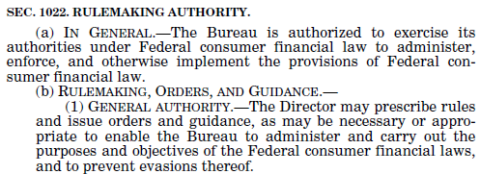
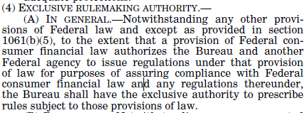
Background: Bureau’s Rulemaking Authority
General rulemaking authority to implement Title X and 18 enumerated statutes
UDAAP rulemaking authority
Exclusive interpretative authority

Slide 37
Standard of Review
Title X prescribes important standards for rulemaking in Section 1022(b)(2)
The APA applies to the Bureau just as it does to other federal agencies
Notice and comment rulemaking
Deference to agency determinations
Lenient review standard (arbitrary and capricious)

Slide 38
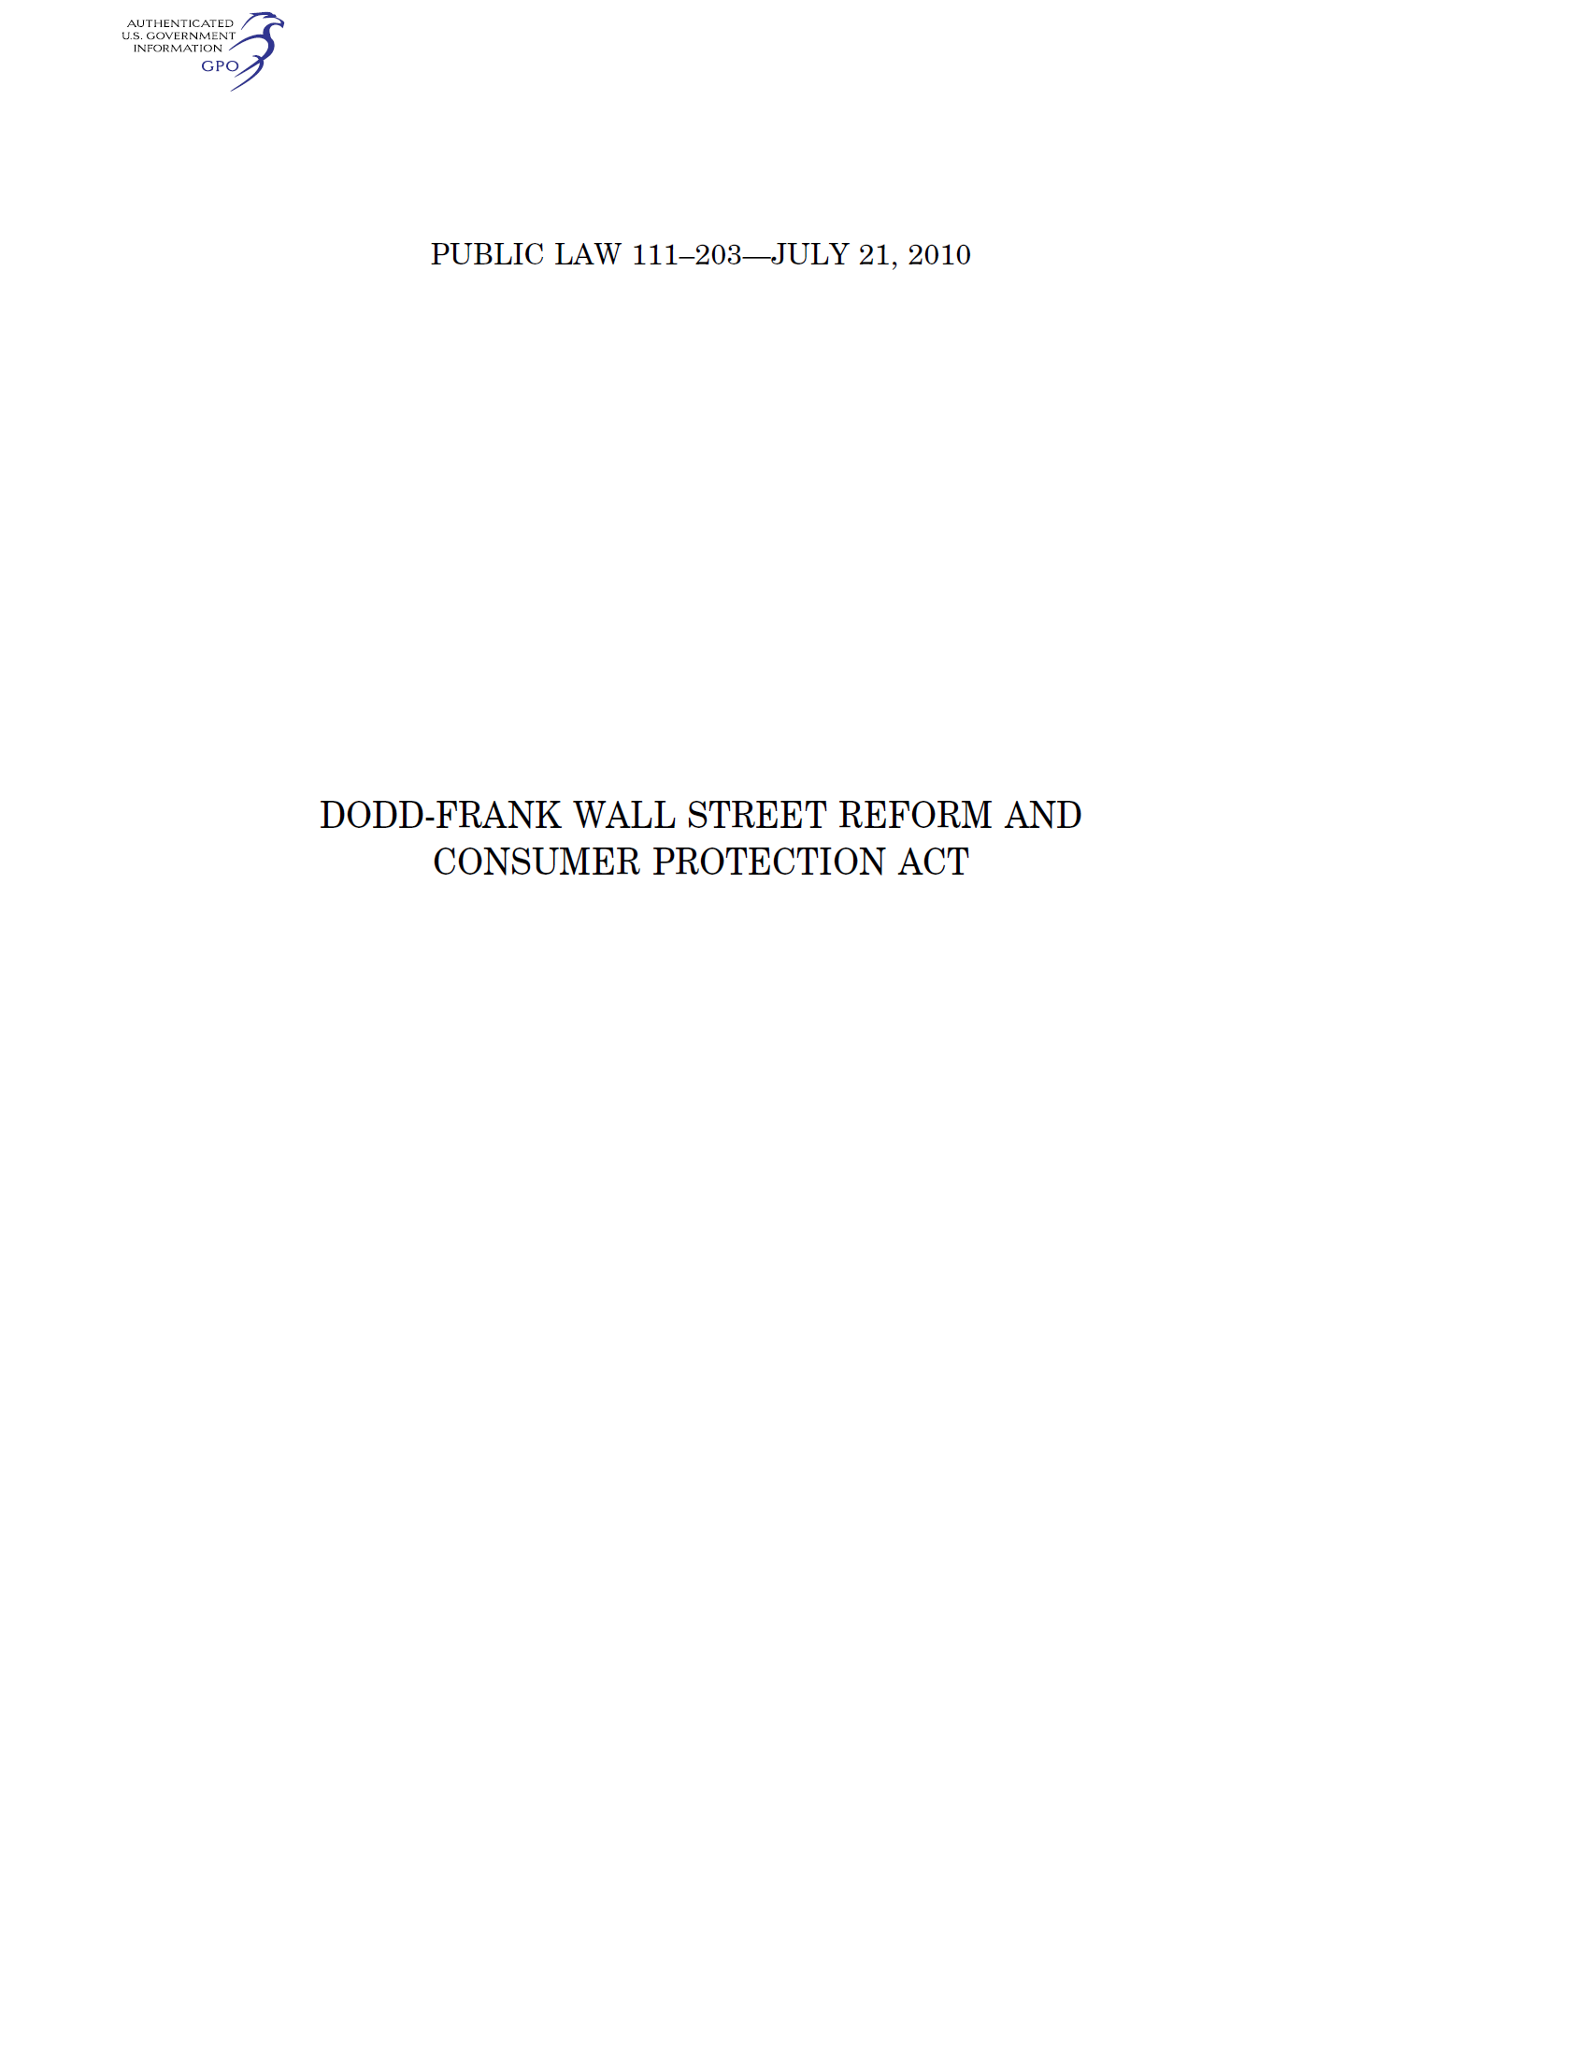
Section 1028 Authority to Study and Restrict Arbitration Clauses
Source: Dodd-Frank Act

Slide 39
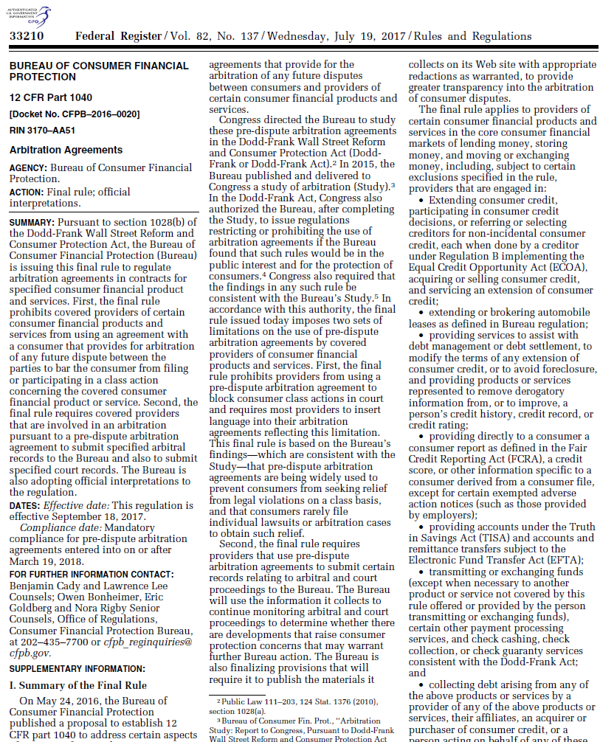
Congress Repeals Arbitration Rule

Slide 40
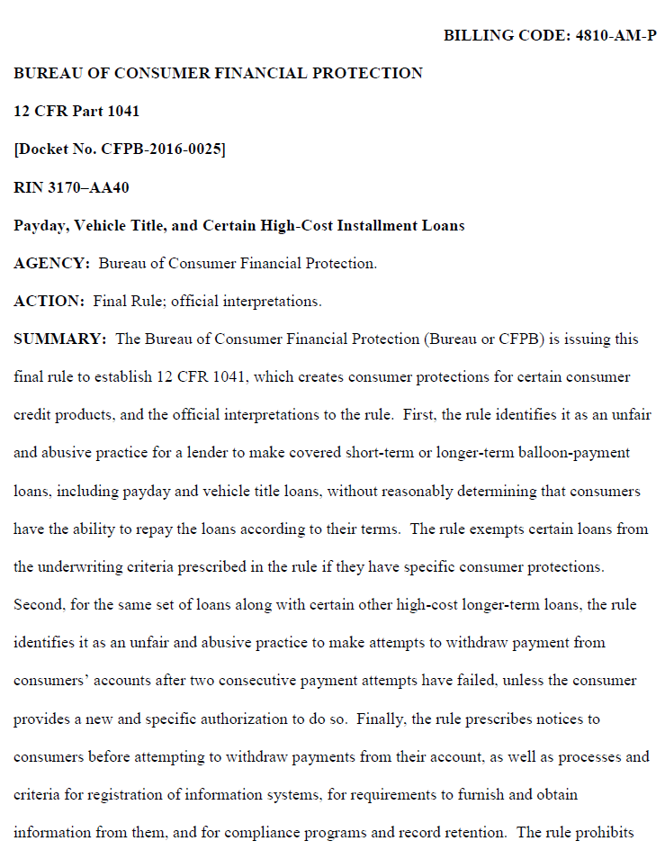
On the Chopping Block The Payday Lending Rule

Slide 41
Rulemaking Agenda
2017
Final Arbitration Rule (now repealed)
Final Payday Lending Rule, effective January 16, 2018 with a compliance date in August 2019
Clarifications to “Know Before You Owe” mortgage rules
2018
Extending supervisory authority to non-bank providers of consumer installment loans and vehicle title loans
Rule implementing Section 1071 of the Dodd-Frank Act requiring financial institutions to maintain and report information on lending to women-owned, minority-owned, and small businesses
Overdraft rulemaking
Debt collection rulemaking
Registration of non-depository financial institutions
?

Slide 42
Questions?
Ryan Scarborough
Williams & Connolly LLP
rscarborough@wc.com
202-434-5173
Rachel Rodman
Williams & Connolly LLP
rrodman@wc.com
202-434-5952

